Slide 1
A Look At DISA STIGs (4)
Firewall Security Technical Implementation Guide
Vulnerability ID: V-3967
Rule name: The console port does not timeout after 10 mins

Slide 2
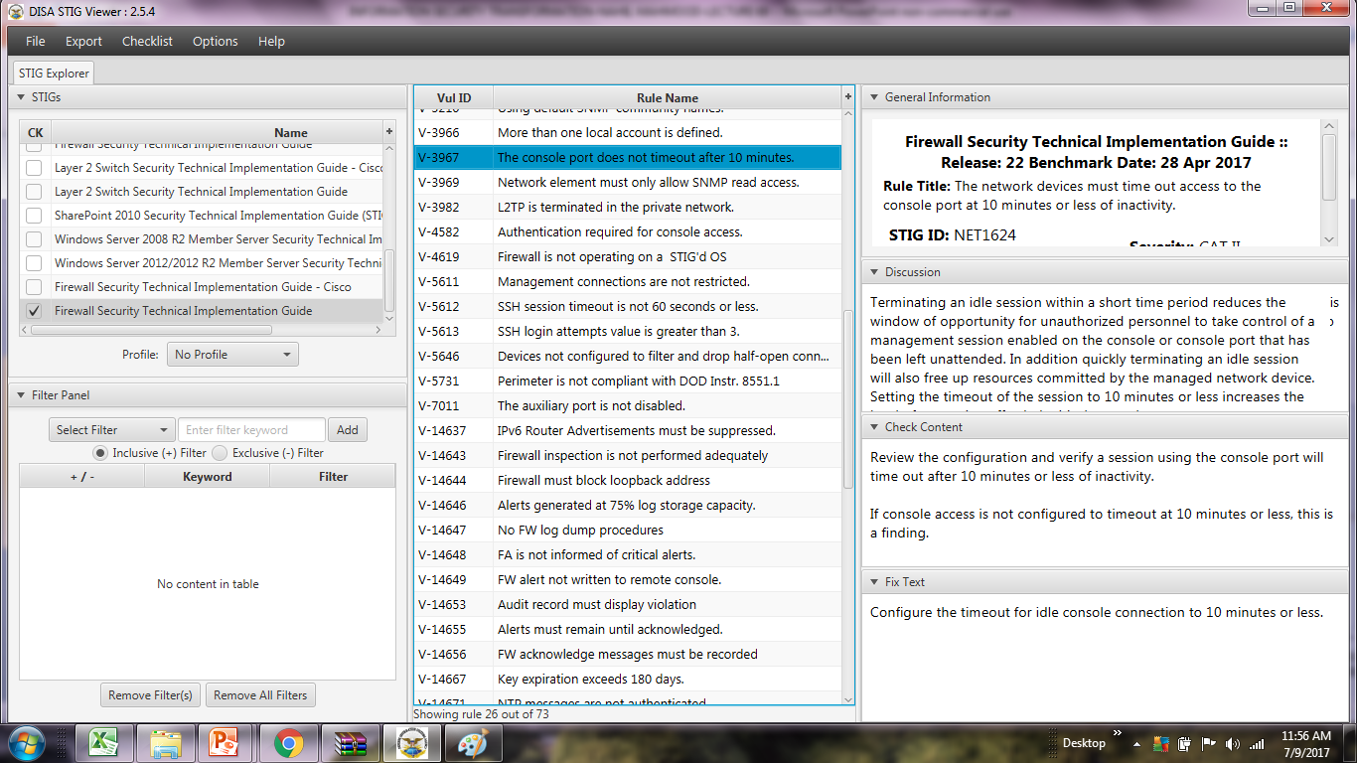
A Look At DISA STIGs (4)
STIGVIEWER WINDOW

Slide 3
A Look At DISA STIGs (4)
General Information:
Rule Title: The network devices must time out access to the console port at 10 minutes or less of inactivity
STIG ID: NET1624
Severity: CAT II

Slide 4
A Look At DISA STIGs (4)
Discussion:
Terminating an idle session within a short time period reduces the window of opportunity for unauthorized personnel to take control of a management session enabled on the console or console…

Slide 5
A Look At DISA STIGs (4)
Discussion…:
port that has been left unattended. In addition quickly terminating an idle session will also free up resources committed by the managed network device. Setting the timeout of the session to 10 minutes

Slide 6
A Look At DISA STIGs (4)
Discussion…:
or less increases the level of protection afforded critical network components

Slide 7
A Look At DISA STIGs (4)
Check Content:
Review the configuration and verify a session using the console port will time out after 10 mins or less of inactivity.
If console access is not configured to timeout at 10 minutes or less, this is a finding.

Slide 8
A Look At DISA STIGs (4)
Fix Text:
Configure the timeout for idle console connection to 10 minutes or less.
END

